Slide 1

Digital Portfolio
STUDENT NAME: VISHNU VARTHAN R
REGISTER NO AND NMID: autunm11024ca124
DEPARTMENT: BCA
COLLEGE: COLLEGE/ UNIVERSITY :UNIVERSITY OF MADRAS
1
Notes:
1

Slide 2

PROJECT TITLE
PORTFOLIO
2

Slide 3



AGENDA
Problem Statement
Project Overview
End Users
Tools and Technologies
Portfolio design and Layout
Features and Functionality
Results and Screenshots
Conclusion
Github Link
3/21/2024 Annual Review
3

Slide 4

PROBLEM STATEMENT
In today’s competitive digital era, a portfolio is essential to showcase skills, projects, and achievements.
Many individuals on resumes or outdated formats that fail to highlight their work effectively.
Without an interactive and modern portfolio, opportunities in professional networking, freelancing, and job recruitment are often missed.
4

Slide 5

PROJECT OVERVIEW
The project is a personal portfolio website designed to showcase my skills, projects, achievements, and experience in a professional and engaging way.
It provides an interactive platform where recruiters, clients, and collaborators can easily explore my work.
5
The project is a personal portfolio website designed to showcase my skills, projects, achievements, and experience in a professional and engaging way.
It provides an interactive platform where recruiters, clients, and collaborators can easily explore my work.

Slide 6

WHO ARE THE END USERS?
Recruiters & Hiring Managers – to evaluate skills, projects, and experience for job opportunities.
Clients – to explore work samples and consider for freelancing or project collaborations.
Peers & Professionals – for networking, feedback, and knowledge sharing.
Educators / Mentors – to review growth, progress, and skill development.
Personal Branding Audience – anyone interested in learning about my career journey and achievements.
6

Slide 7

TOOLS AND TECHNIQUES
Frontend Development:
HTML5, CSS3, JavaScript
Version Control & Hosting:
Git & GitHub for code management and collaboration
7

Slide 8
POTFOLIO DESIGN AND LAYOUT
Homepage: Clean introduction with name, role, and tagline.
About Section: Personal background, education, and professional summary.
Skills Section: Visual representation of technical and soft skills.
experience section : that boost the hr
Projects Section: Showcasing major projects with descriptions, screenshots, and links.
Contact Section: Easy access to email, phone, and social media links.
Responsive Design: Optimized for desktops, tablets, and mobile devices.
8

Slide 9
FEATURES AND FUNCTIONALITY
Responsive Design – Works seamlessly on desktop, tablet, and mobile devices.
Interactive UI – Smooth navigation with modern animations and transitions.
Projects Showcase – Displays portfolio projects with images, descriptions, and live/demo links

Slide 10
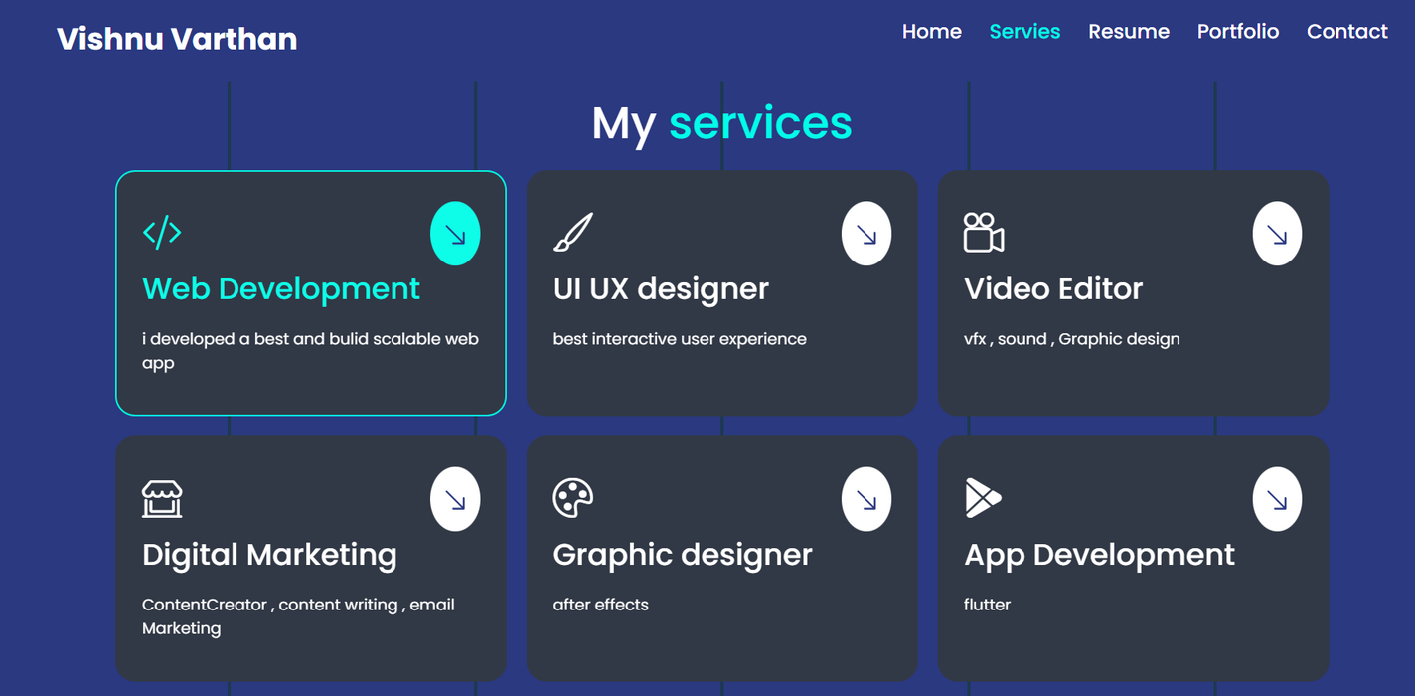

RESULTS AND SCREENSHOTS
3/21/2024 Annual Review
10

Slide 11
CONCLUSION
The portfolio project demonstrates my technical skills, creativity, and personal branding.
It provides a centralized platform to showcase projects, skills, and achievements.
Designed with modern web technologies to ensure responsiveness and user engagement.
Acts as a professional identity for career opportunities and networking.
11

Slide 12
GITHUB LINK
https://github.com/Vishnu-Varthan1/TNSDC-FWD-DP.git
2

